Slide 1

Northwind Traders Sales Reports
MSDA 673
Dhrisya Damodaran

Slide 2
The 3-Minute Story
The company ships products currently to 21 countries
US and Germany contribute to more than 35% of the revenue
There are 77 distinct products that are shipped by the company
7% of the products generate 30% of the total revenue
50% of the products generate less than 20% in revenue
The sales data of Northwind traders was analyzed over a period of 23 months

Slide 3
Big Idea
LESS IS MORE
Northwind Traders need to reduce their global presence and also their product line to concentrate on top selling countries and products, this will lead to more profitable operation since overheads of localizations and support will reduce

Slide 4
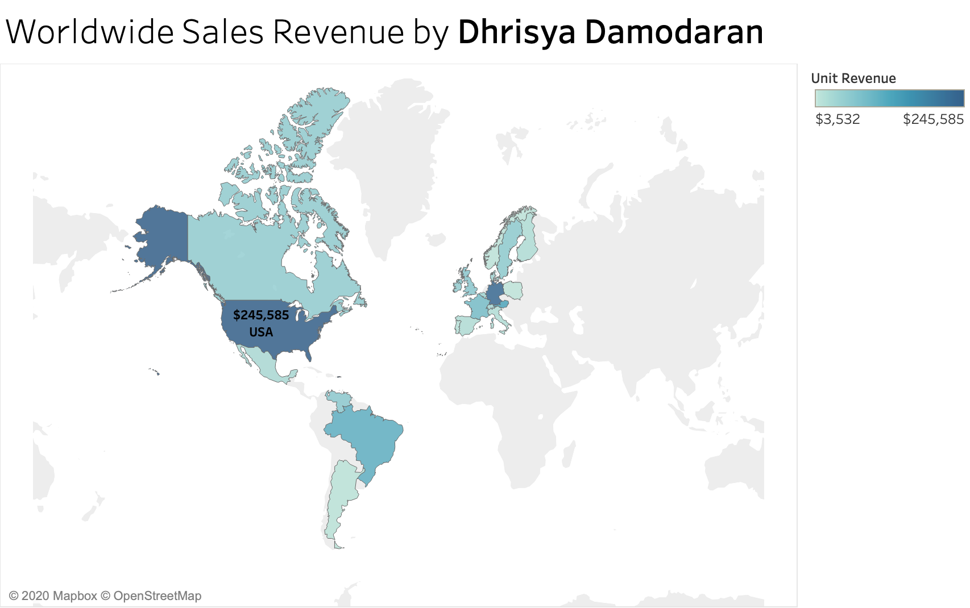

Slide 5
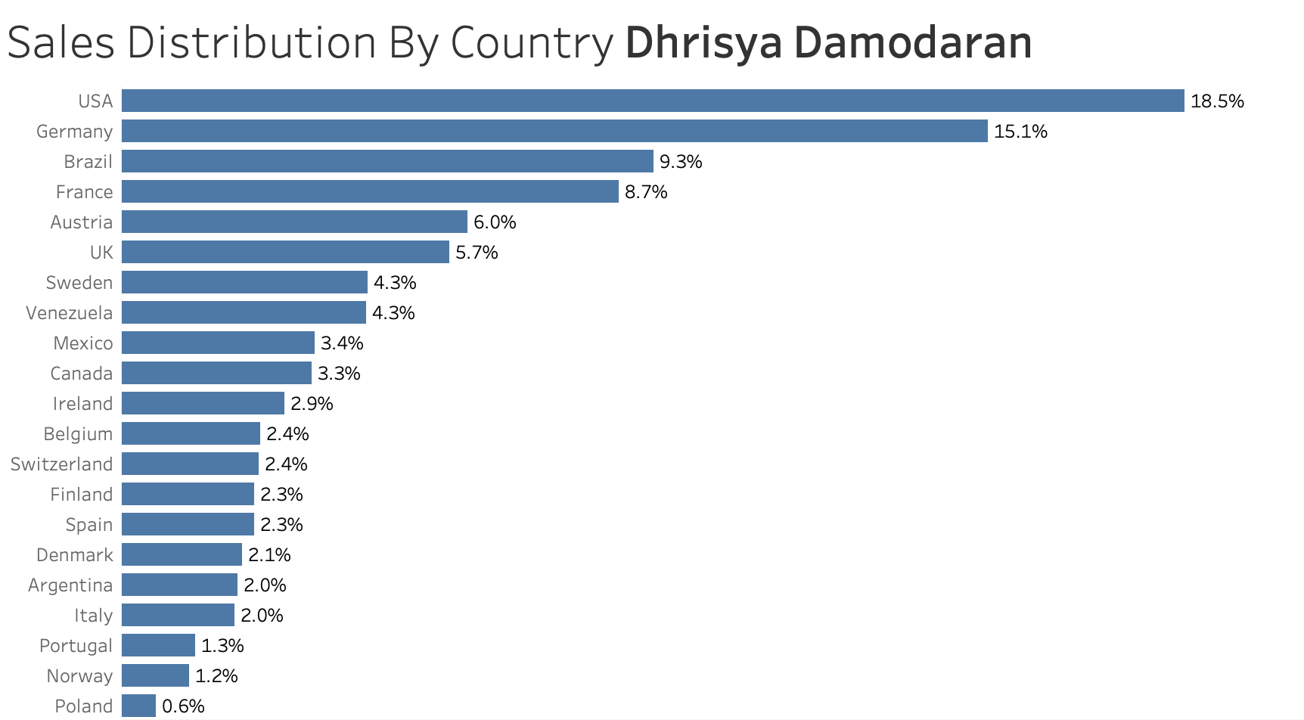

Slide 6
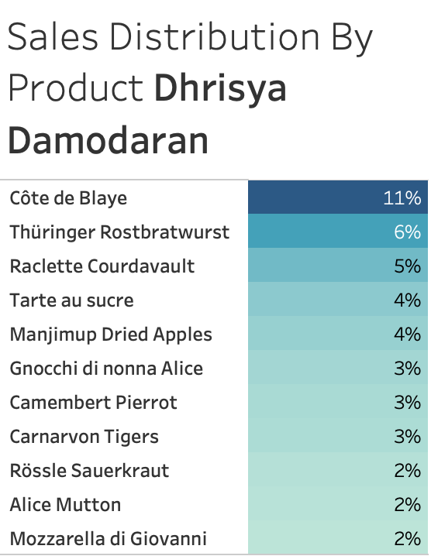

Slide 7
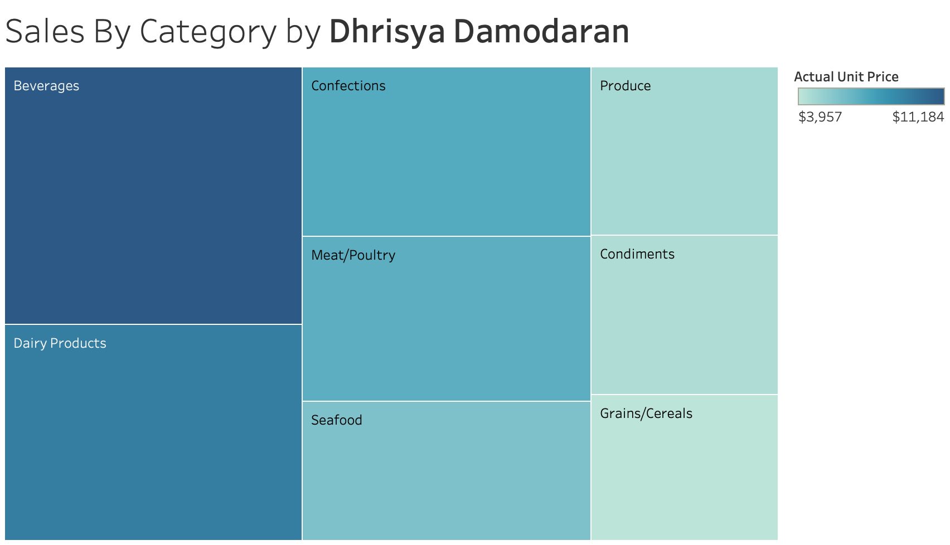

Slide 8
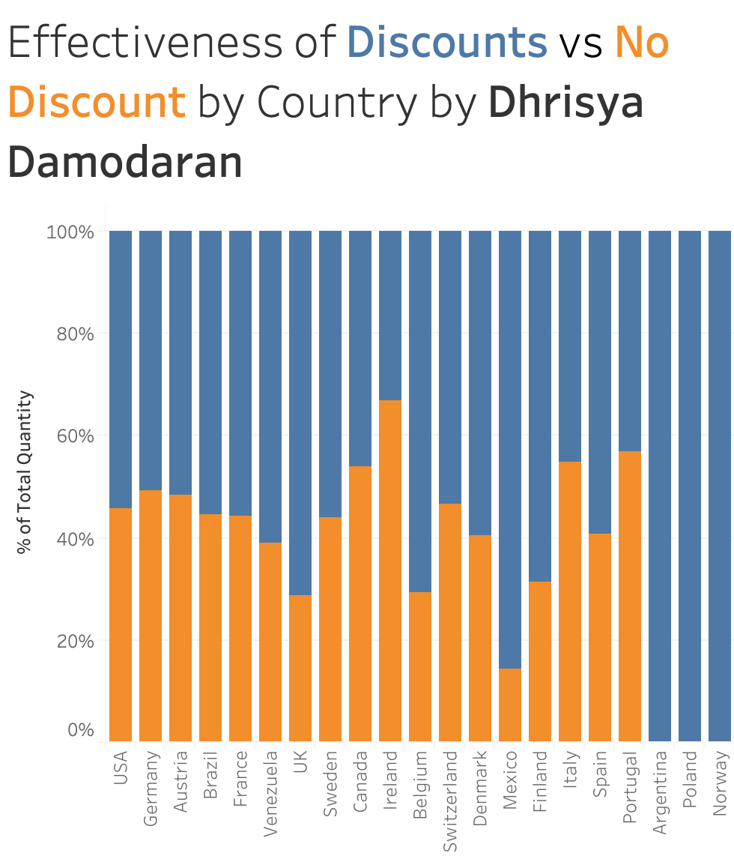

Slide 9
Conclusion
Recommendations are :
Concentrate effective marketing and discount strategies in US and Germany
Cutting down on the product line to only focus on top 10 products

